Slide 1
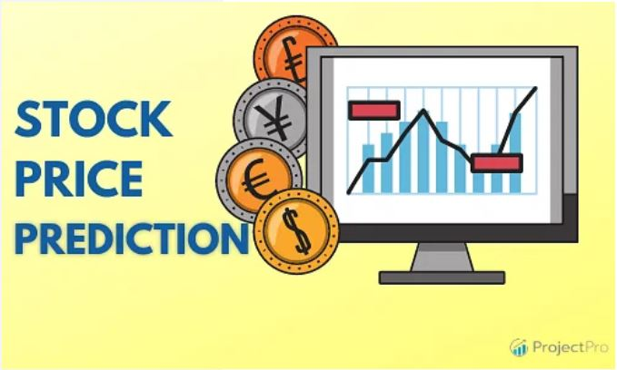
Apple Stock Price Prediction

Slide 2
Mentor & Team Member Details
Mentor :- Dilawar Basha & Prajwal
Team Members:-
Falak Hashmi
Shanmukha Sasank Nandula
Jemiyah Lijo
PALAMALA PENCHALA SWAMY
Chandana S
Pankaj Kumar Singh
Kasturi Sai Ganaamruth

Slide 3
Objective
The primary objective of the Apple Stock Price Prediction Project is to accurately forecast the future stock prices of Apple Inc. (AAPL) using historical stock market data. By analyzing past trends, seasonal patterns, and price movements, this project aims to develop a reliable predictive model that can assist investors, analysts, and financial planners in making informed decisions. The project leverages statistical methods such as ARIMA/SARIMA, and machine learning algorithms like XGBoost or LSTM, to capture the underlying structure of the time series data. Ultimately, the goal is to provide data-driven insights into future price movements, helping to identify potential investment opportunities and minimize risks in stock trading.

Slide 4
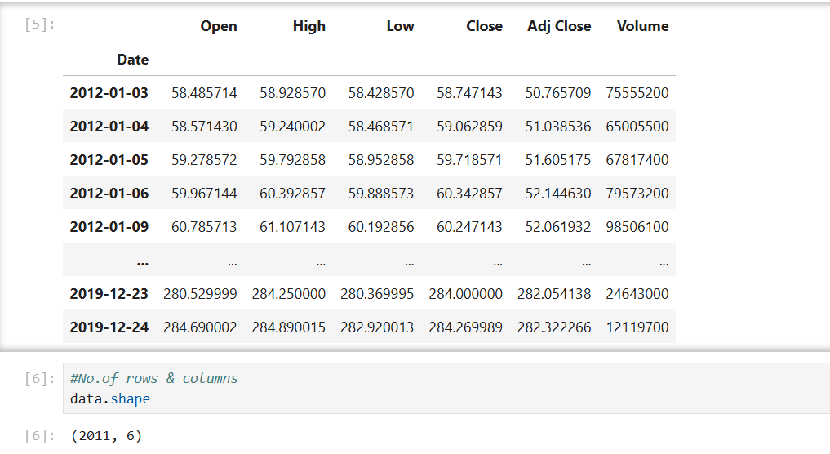
Dataset Details : Apple Inc. Stock Prices
The dataset contains historical stock price data for Apple Inc. (AAPL). It is a time series dataset, typically used for financial analysis and forecasting tasks. Contains 2011 rows and 6 columns.
Key Columns:
Date – The trading date (daily frequency).
Open – Price of the stock at market open.
High – Highest price reached during the trading day.
Low – Lowest price reached during the trading day.
Close – Price of the stock at market close.
Adj Close – Adjusted close price accounting for dividends and stock splits.
Volume – Number of shares traded on that day.

Slide 5
Data Preprocessing
To prepare the Apple stock data for time series forecasting, several preprocessing steps were performed:
1. Aligning with U.S. Business Days:
*A Custom BusinessDay calendar was created using the US Federal Holiday Calendar to define valid trading days, excluding weekends and U.S. public holidays.
*A date range (my_range) was generated from 2012-01-03 to 2019-12-30 using this custom calendar.
2. Handling Non-Trading Days:
*The dataset (data) was compared against my_range to identify any mismatched dates.
*Additional custom holidays (like Good Friday and market-closed days not included in the standard calendar) were manually added to ensure alignment.
3. Filtering by Frequency:
*The dataset’s frequency was set to the refined Custom Business Day calendar, ensuring consistent time intervals for modeling.
*Non-trading days were excluded, and the index was set to valid business dates only.
4. Dropping Unnecessary Columns:
*Columns not required for forecasting (Open, High, Low, Close, Volume) were removed.
*Only the Adj Close column was retained, as it reflects stock prices adjusted for splits and dividends.
5. Saving the Cleaned Dataset:
*The cleaned and preprocessed dataset was saved as new_Apple_data.csv for future use in modeling

Slide 6
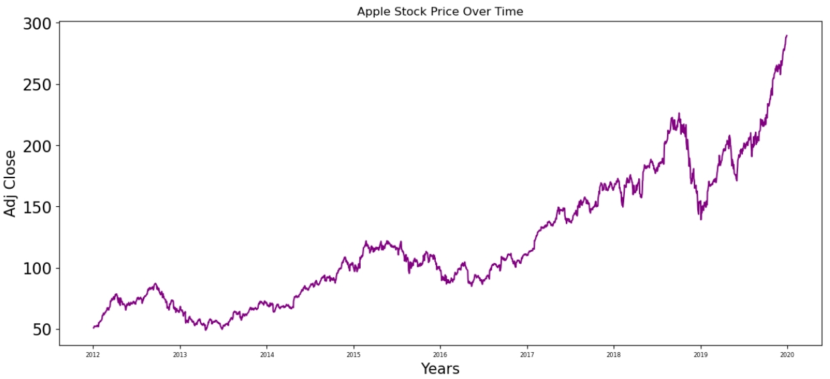
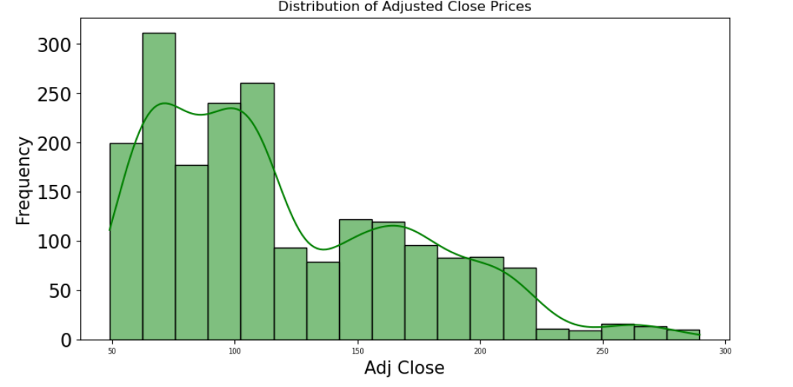
Exploratory Data Analysis (EDA)
Apple Stock Price Over Time
Distribution of Adjusted Close Prices
The chart shows a steady rise in Apple’s adjusted stock price from 2012 to 2019, with periods of short-term volatility. It highlights strong long-term growth, especially after 2017, indicating increasing investor confidence and market performance.
The distribution plot shows that most of Apple’s adjusted close prices fall between $50 and $150, with a right-skewed pattern. Higher prices are less frequent, indicating consistent growth over time with fewer occurrences of high-price peaks.

Slide 7
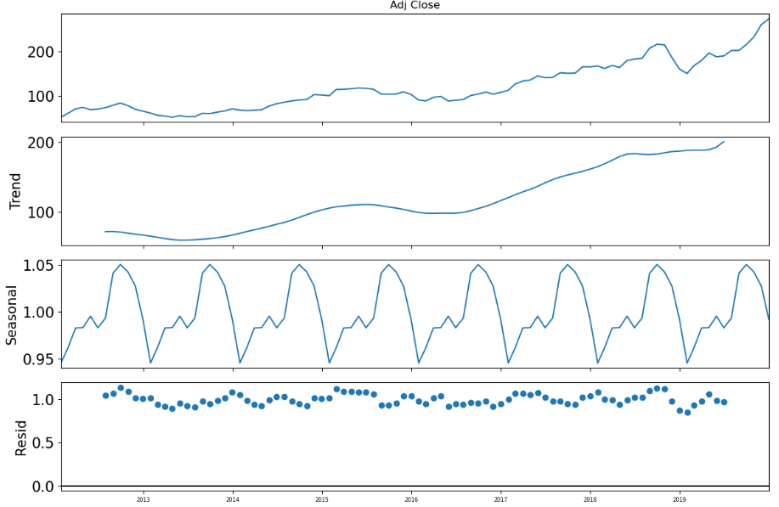
Time Series Decomposition of Apple Stock Prices(EDA)
The decomposition plot shows a clear upward trend in Apple’s stock prices over time, with strong yearly seasonality. The residuals remain relatively stable, indicating that the multiplicative model captures both the trend and seasonal patterns effectively.

Slide 8
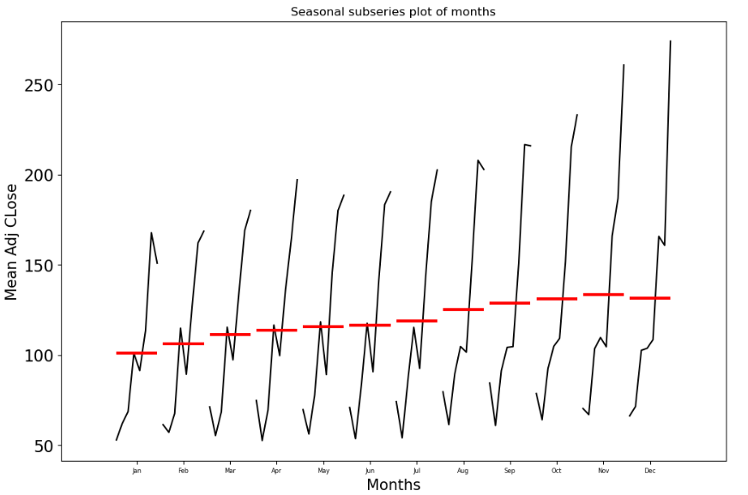
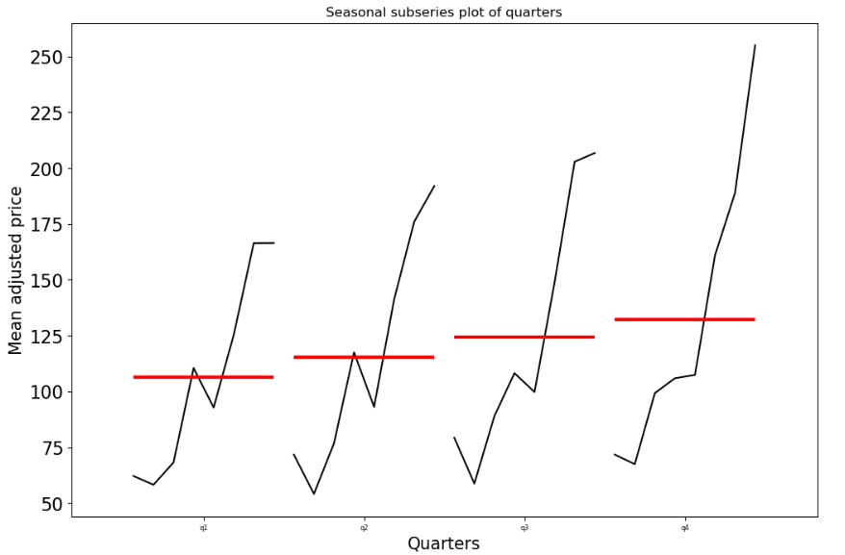
Exploratory Data Analysis (EDA)
Monthly Seasonal Subseries Plot
Quarterly Seasonal Subseries Plot
The seasonal subseries plot shows a clear yearly upward trend in Apple’s average stock prices, with noticeable month-wise patterns. Prices tend to rise sharply toward year-end, especially in November and December, indicating strong seasonal effects.
The quarterly subseries plot reveals a consistent upward trend across all quarters, with the highest stock prices typically observed in Q4. This suggests strong year-end performance, likely influenced by product launches and holiday season demand.

Slide 9
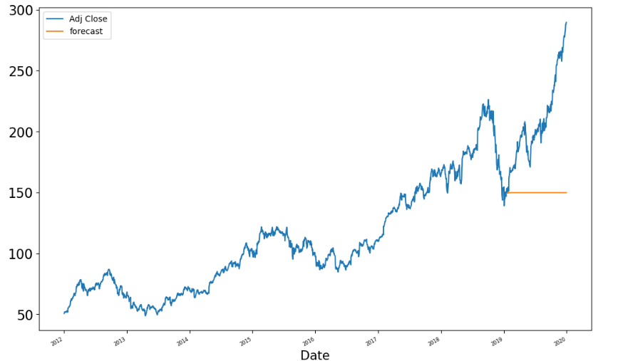
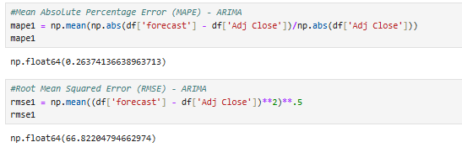
Model Building using ARIMA
An ARIMA(1,1,1) model was used to forecast Apple’s adjusted stock prices. The model achieved a MAPE of 26.37% and RMSE of 66.82, indicating moderate prediction accuracy with noticeable forecasting error compared to advanced models.

Slide 10
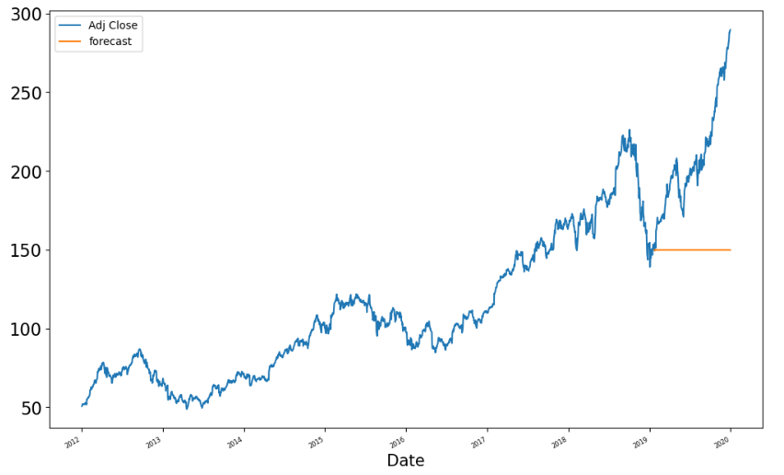
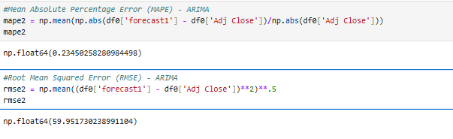
Model Building using SARIMA
The SARIMA model was implemented using the SARIMAX class to forecast Apple’s stock price. The plot shows actual vs. predicted values, A SARIMA(1,1,1)(1,1,1,30) model was applied to forecast Apple’s stock prices. It achieved a MAPE of 23.45% and RMSE of 59.95, showing improved accuracy over the ARIMA model by better capturing seasonality and reducing prediction error.

Slide 11

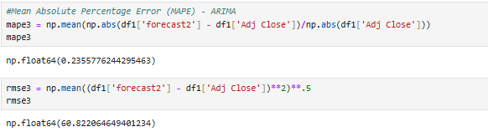
SARIMA Model(Quarterly)
A second SARIMA model was trained with a seasonal period of 63 to improve forecasting. The plot compares actual prices with both SARIMA forecasts. This helps evaluate which seasonal configuration better captures Apple’s stock price patterns over time.
The second SARIMA model (seasonal period = 63) achieved a MAPE of 23.56% and RMSE of 60.82. While slightly less accurate than SARIMA-30, it still provides a competitive forecast and helps analyze the impact of different seasonal settings.

Slide 12
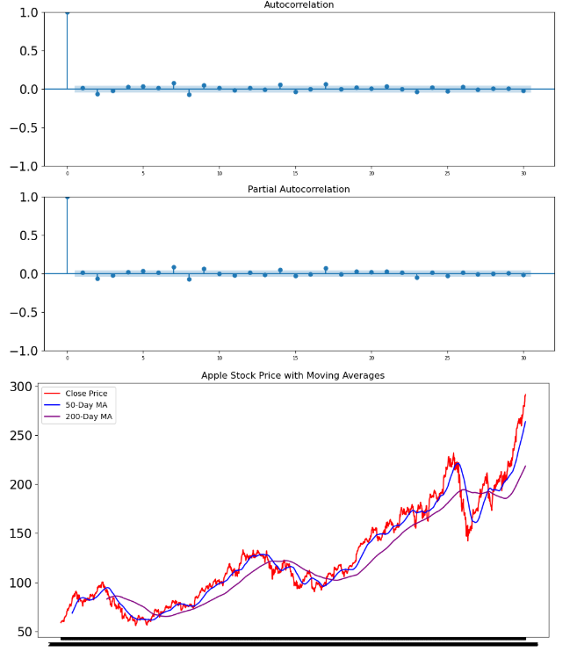
Model Building (XG Boost)
The plot shows Apple’s stock price alongside its 50-day and 200-day moving averages. It highlights both short-term and long-term trends, helping identify momentum shifts. Crossovers between the averages indicate potential buy or sell signals.
The ACF and PACF plots show minimal autocorrelation, suggesting weak linear dependence in daily returns. The moving average plot confirms a strong long-term upward trend in Apple’s stock, with 50-day and 200-day MAs supporting trend analysis.

Slide 13
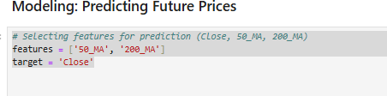
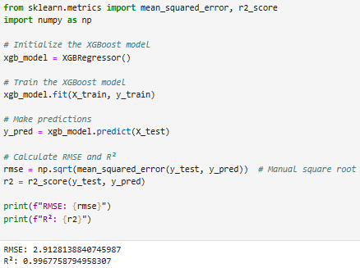
Model Building (XG Boost)
The XGBoost regressor was trained on Apple stock features to predict closing prices. It provided RMSE and R² scores, showing strong model performance with enhanced prediction accuracy compared to linear and ARIMA-based models, thanks to its gradient boosting capability. The XGBoost model achieved an RMSE of 2.91 and an R² score of 0.997, indicating highly accurate predictions with minimal error. It significantly outperforms linear and ARIMA-based models, effectively capturing patterns in Apple’s stock price data.

Slide 14
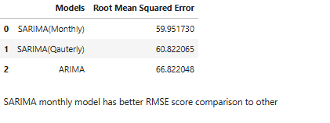
Model Evaluation and Selection
Summary of RMSE Comparison
Among all models:
SARIMA (Monthly) has the lowest RMSE (59.95),
Followed by SARIMA (Quarterly) (60.82),
And ARIMA performs the worst (66.82).
🔍 Conclusion: SARIMA (Monthly) outperforms others in terms of predictive accuracy, making it the best statistical model for Apple stock forecasting in this analysis.

Slide 15
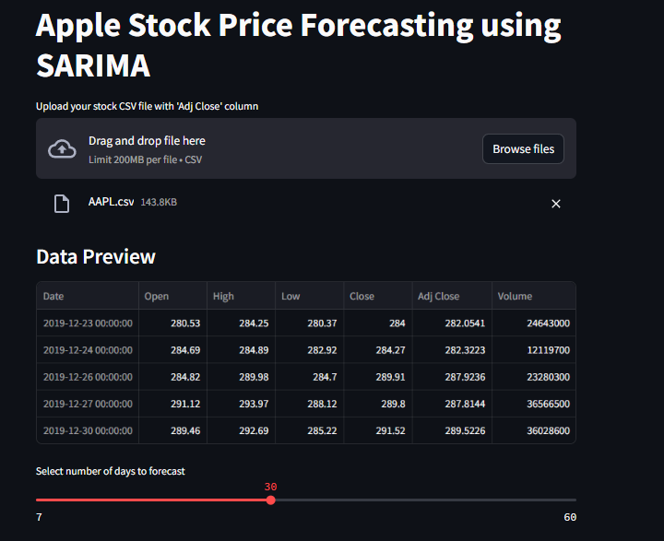
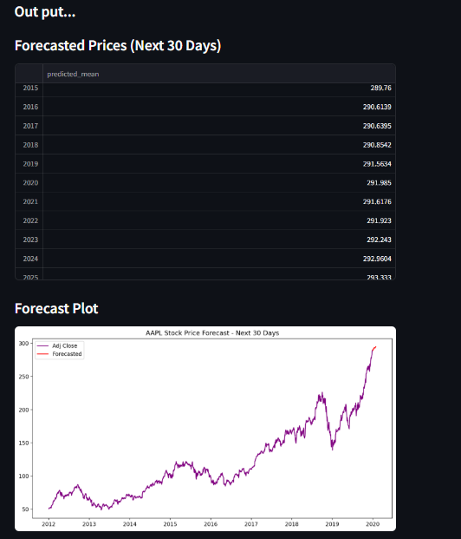
Deployment

Slide 16
Challenges Faced During the Project
Understanding Project Requirements As a beginner, it was initially difficult to fully grasp the expectations, scope, and flow of a real-time stock forecasting project.
Confidence in Decision-Making As a fresher, lack of confidence in model selection or analytical decisions made it harder to contribute assertively in team discussion
Data Gaps and Non-Trading Days Handling missing dates due to weekends, holidays, and market closures required careful frequency alignment and holiday calendar adjustments.
Seasonality Detection Identifying the right seasonal order (monthly vs. quarterly) in SARIMA models was complex and required trial and error.
Model Selection and Tuning Choosing between ARIMA, SARIMA and XGBoost involved comparing multiple metrics and tuning hyperparameters for best performance.
Computational Time Fitting SARIMA models with large seasonal orders (like 63) took significant time and memory.

Slide 17
Thank You…

